Slide 1

Real-Estate Smart Prediction System

Slide 2
Supervisor:
Dr. Sherine Rady
TA. Amal Moustafa

Slide 3
Team members:
Abdelrahman Mohammed Ahmed.
Amany Adel Soliman.
Shehab Adel Abdelgleel.
Abeer Ahmed Sholkamy.
Osama Ahmed Ahmed.
Esraa Mohammed Abdelhameed.

Slide 4
Agenda:
Introduction.
Problem definition.
Objective.
Features.
Related works.
System Architecture.
Software tools.
References.

Slide 5

Introduction:
Real-Estate market in Egypt has always been challenging to deal with many features in the estate define it's values and our part is to let you know which one of them matters the most.

Slide 6

Problem Definition:
In a market like Egypt it is very hard to find an appropriate estate with a reasonable price, owner find trouble in finding a buyer.

Slide 7

Objective:
Offering help in finding the estate you need in fastest time and easiest way.
Help you to sell your estate.
Predicting the price of a estate based on the giving features.
Prediction whether the estate appropriate for investment or not?

Slide 8
Features:
Users can register & log in.
Each user have a profile with public rate.
Filtering estates by regions ,rate and price.
User can either rent or offer his estate for rent.
Each user can buy or sell.
Recommending estates that are nearby to the selected location.
Making a wish list of items.
Included messaging system between users.
Rating and reviewing system happens after the completion of the deal.
Previewing the offers and discounts in the top.
Show top 10 sales & top 10 sellers according to rating and people’s evaluation of them per week.

Slide 9
Features (Cont…):
Prediction for price by space and location.
Algorithm to find the estate with the highest rate, lowest Price and largest space.
Market risk price accuracy after 10 years(Bays rule):
(using some information about the estate, system can tell the user the percentage of risk over the next 10 years).
Predict the price range(clustering).
The identity of the buyer and seller is verified before delivery and dealing between them.

Slide 10
Features (Cont…):
There will be part like auction:
Seller can add his estate and choose date of auction’s starting.
Buyer can add this estate to his wish list and get notification before starting.
There is screen with highest price and name of the owner of the highest price, screen update automatic when another buyer enter high price.
When auction end buyer and seller get message with info. about each others included phone number.
The higher auction price, the higher the risk.

Slide 11
Related works:
Features | Our System | Bigger pockets | LoopNet | Xome | Buffer
Register and login | Yes | Yes | Yes | Yes | Yes
Filtering estates by regions | Yes | No | Yes | Yes | No
Making a wish list of visited items | Yes | No | No | Yes | Yes
User can either rent or offer his estate for rent | Yes | Yes | No | No | No
Predict the price range | Yes | No | No | No | No
Rating and reviewing | Yes | No | No | No | Yes
Prediction for price by space and location | Yes | No | No | No | No
Auction system | Yes | Yes | Yes | Yes | No
Chat between users | Yes | Yes | Yes | Yes | No
Search by satellite | No | No | No | Yes | No

Slide 12
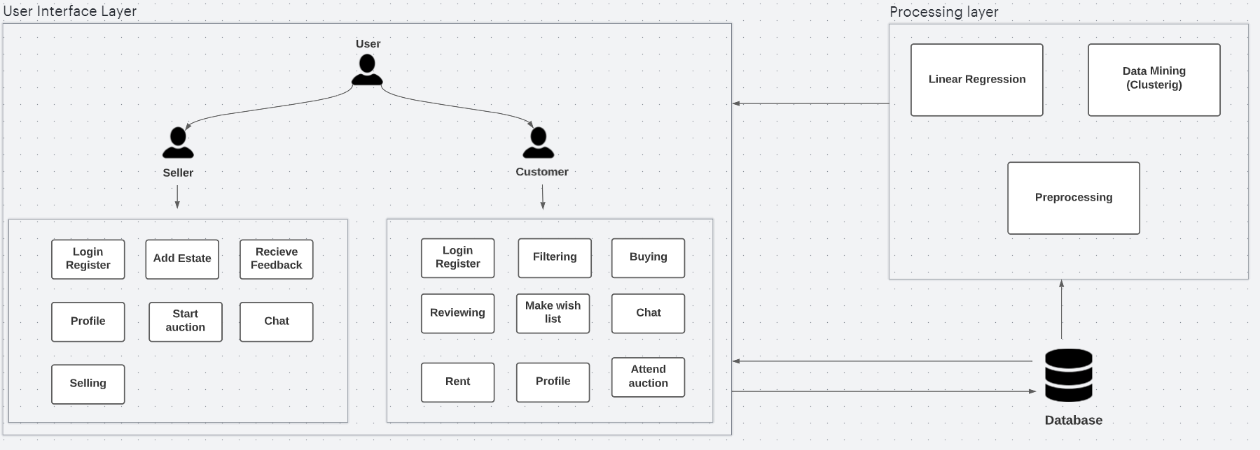
System Architecture:

Slide 13




Software Tools:
C# & .Net framework
To manage back-end.
Python in Linear Regression
HTML , CSS & JS
React to design
front-end.
Database

Slide 14
References:
https://www.fortunebuilders.com/real-estate-apps/ (Related works)
https://towardsdatascience.com/a-data-science-web-app-to-predict-real-estate-price-d2366df2a4fd (Related works)
https://www.biggerpockets.com/ (biggerpockets)
https://www.loopnet.com/ (LoopNet)
https://www.xome.com/ (Xome)
https://www.kaggle.com/datasets/mohammedaltet/egypt-villas-with-amenities-price (Dataset)

